Slide 3
AGENDA
Benefits of Owning a Home
Credit Fundamentals
Mortgage Basics
Looking for a Home and Calculating Affordability
Obtaining a Mortgage/Comparing Finance Options
Loan Approval Phase
Preparing for Closing
Maintaining Homeownership
3

Slide 4
BENEFITS OF OWNING A HOME
Benefits of Homeownership: Powerful Source of Wealth
Tax Deductions
Mortgage interest and property tax payments may be included as itemized deductions on federal and/or state income taxes. Consult with your tax advisor.
Mortgage Insurance (MI) premiums may be tax deductible. Consult with your tax advisor.
The Power of Amortization
Making each monthly payment reduces the loan balance, increasing your equity in the property.
Appreciation
As your property value increase, this provides another powerful long-term wealth accumulation vehicle for your family’s financial security.
Personalization
Personalize your property and its decor, as you see fit.
Inheritance
You own something tangible that can be left to your heirs to help establish their financial security.

Slide 5
BENEFITS OF OWNING A HOME
Key Areas to Consider:
Requirements
Buying a home requires significant upfront cash. These expenses typically include a down payment, closing costs and reserves.
Increase in Expenses
You will need to budget for maintenance/upkeep, property taxes, insurance and homeowner association (HOA) fees (if you are moving into a community that requires these).
Property Function
Your property value may fluctuate, so it is important to stay focused on the long-term benefits of home ownership.
Limited Flexibility
Can limit flexibility to relocate for a job or change neighborhoods.
Limited Budget
May require you to more closely follow a budget.

Slide 6
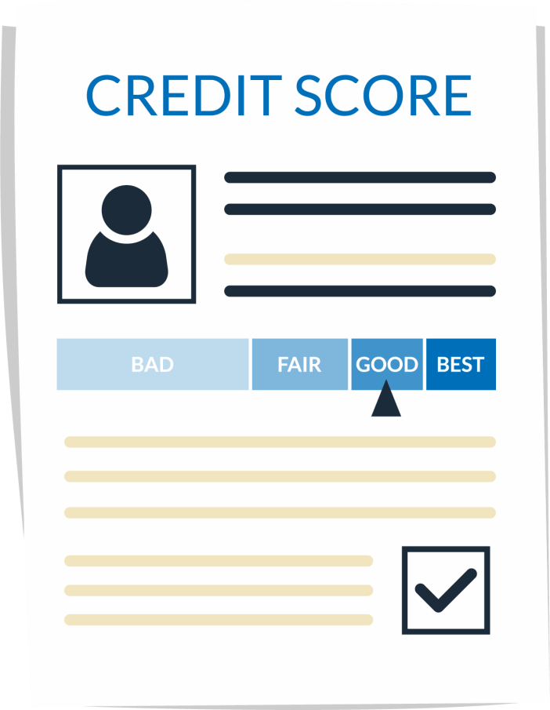
CREDIT FUNDAMENTALS
Credit Scores
Credit bureaus provide credit unions your credit scores based on payment patterns and the nature of your credit use.
A credit score is calculated based on:
Your previous credit performance.
Current debt levels.
The depth of your credit file: How far back your credit history runs and the amount of information on your
payment patterns.
Whether you have recently added new debt.
The type and frequency of debts you take on.

Slide 7
CREDIT FUNDAMENTALS
How to Improve or Protect Your Credit Profile:
Pay your bills on time and include at least the minimum amount due.
Don’t “max out” your credit cards.
Limit the number of credit cards you have.
Avoid impulse buying on major purchases.
You are responsible for all joint accounts opened with another individual and for all loans on which you’re the co-signer.
Co-signing a loan is generally not a good idea. If an individual requires a co-signer, it’s likely an indication that he or she can’t afford the loan.
Review your credit report at least once each year. Get reports from several major credit agencies.
Treat student loans like any other debt and pay on time.

Slide 8
MORTGAGE BASICS
Length/Term of the Mortgage
The period of time during which you pay back the loan will also determine the amount of your payment. The longer the term of the loan, the lower the mortgage payments. For that reason, many first-time homebuyers prefer a 30-year loan. However, rates for shorter terms (including 15-year loans) are generally lower and build equity faster.
Components of a Mortgage Payment: PITIA
P stands for Principal or the amount you borrowed.
I stands for Interest.
Credit unions charge interest on the money you are borrowing. The interest generally reflects prevailing market rates based on investor demands.
T is for Taxes.
Property Taxes.
I (Final I) represents Insurance.
Homeowners insurance premiums (hazard insurance) is mandatory.
A stands for Association, as in homeowner association.
For some residential properties, HOA dues are required.

Slide 9
MORTGAGE BASICS
Fixed Rate vs. Adjustable Rate
With a fixed-rate loan, the interest rate charged by the credit union never changes over the life of the loan. That means the P (principal) and I (interest rate) portion of your PITIA payment will not change. However, the T (taxes) and I (insurance) portions may change if your taxes or insurance premium change. Many people prefer the stability of a fixed-rate loan.
With an adjustable-rate loan, the interest rate can increase or decrease. There are a large variety of adjustable-rate mortgages (ARMs).
Government Loans vs. Conventional Loans
Government loans include VA loans guaranteed by the Veterans Administration, FHA (Federal Housing Administration) loans administered by the U.S. Department of Housing and Urban Development (HUD) and USDA Rural Loans insured by the U.S. Department of Agriculture.
If a loan is not insured or guaranteed by a government agency, it is considered to be a conventional loan. These loans are often purchased by Fannie Mae and Freddie Mac, although this purchase is typically invisible to the member. If you have less than a 20% down payment, you will likely need private Ml. The advantage of Ml is that you need less upfront cash and can buy your home sooner.

Slide 10
LOOKING FOR A HOME AND CALCULATING HOW MUCH YOU CAN AFFORD TO BORROW
Beginning to look for a Home:
Getting Pre-Qualified
archmicu.com/rtho_worksheets
Refer to Worksheet No. 3 for an approximate calculation of your maximum mortgage amount and monthly payment.
Selecting an Agent
archmicu.com/rtho_addendum
archmicu.com/rtho_resources
For further information, consult the Addendum: Shopping for Your Home packet.

Slide 11
LOOKING FOR A HOME AND CALCULATING HOW MUCH YOU CAN AFFORD TO BORROW
A credit union considers the following factors in deciding what you can afford:
Income and employment.
archmicu.com/rtho_worksheets
See Worksheet No. 1 to calculate Gross Monthly Income.
Other debts (for example, car and student loans, credit cards, etc.).
Debt-to-Income Ratio.
archmicu.com/rtho_worksheets
Refer to Worksheet No. 2 to calculate Monthly Debt Payments.
Down payment.
Cash available after closing (reserves).
Type of mortgage product.
Interest rate of the mortgage.
Length or term of the mortgage.
Credit history.

Slide 12
OBTAINING A MORTGAGE AND COMPARING FINANCING OPTIONS
Applying for a Mortgage:
Checklist of documents the credit union will typically ask for:
archmicu.com/rtho_worksheets
Refer to Worksheet No. 4.
Mortgage Brokers/Bankers
Mortgage brokers are licensed originators representing multiple lenders who work as intermediaries to secure a mortgage for a borrower.
Mortgage bankers originate and fund the loan with the funds of the lender they work for, but immediately sells the loan to another lender, an investor, or directly to Fannie Mae or Freddie Mac.
Consider and compare potential fees that will be charged up front and at closing.

Slide 13
OBTAINING A MORTGAGE AND COMPARING FINANCING OPTIONS
Comparing Products (Part 1)
Rates
Lock-in option preferable. Generally, the longer the loan period, the higher your interest rate.
Term
The longer the term, the lower the monthly payment. However the equity buildup is slower as well.
ARMs
Carefully consider your ability to absorb higher payments if the rate increases.
Points
Discount points represent the upfront payment of interest to the lender. The lower the interest rate, the higher the discount points and vice versa. Each point is 1% of the loan amount.
Origination points are charged to offset the administrative cost of processing and originating your loan. They can also include a document preparation or underwriting fee.

Slide 14
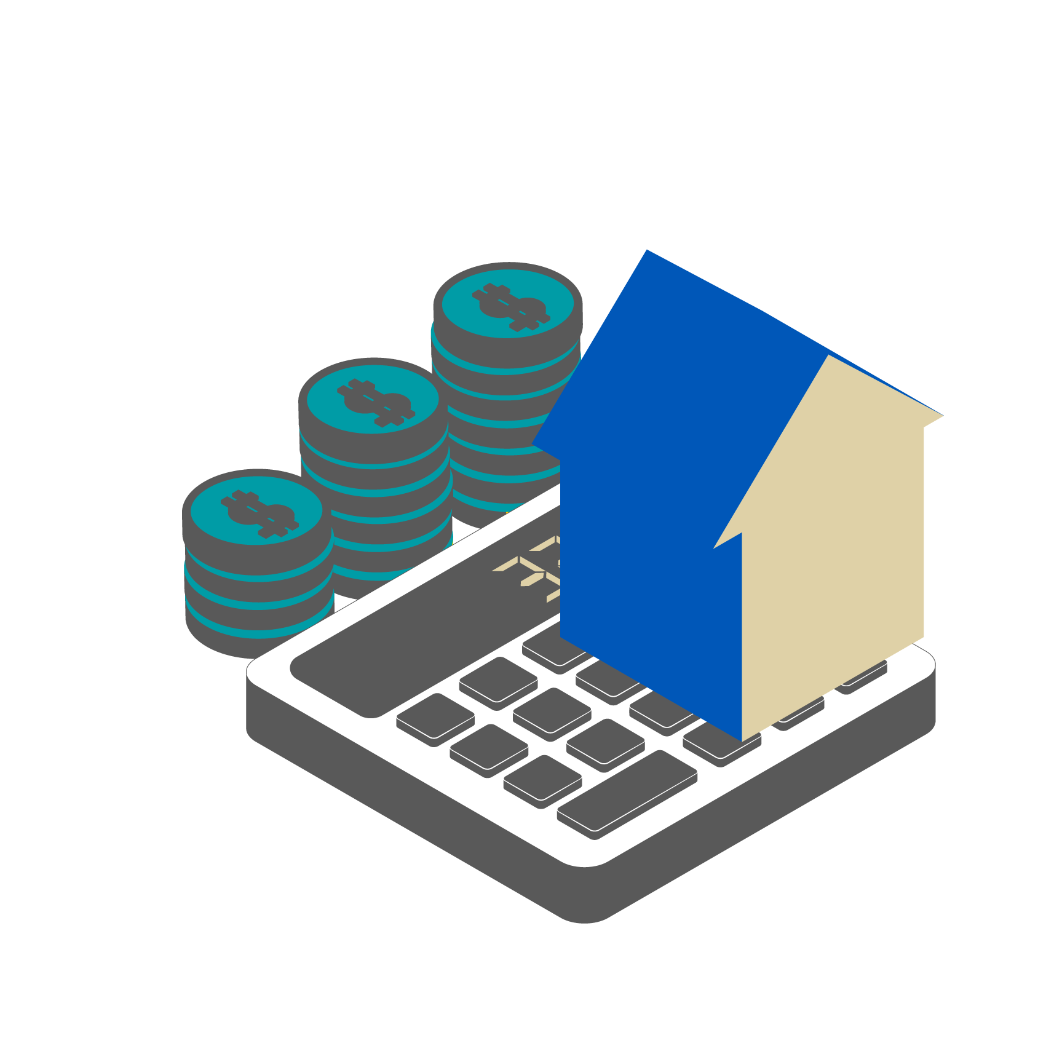
OBTAINING A MORTGAGE AND COMPARING FINANCING OPTIONS
Comparing Products (Part 2)
Down Payment
What is the minimum down payment required? Will MI be required? If so, what is the cancellation policy on the insurance premium?
archmicu.com/rtho_worksheets
Refer to Worksheet No. 4 for a list of factors to consider when shopping for a mortgage.

Slide 15
OBTAINING A MORTGAGE AND COMPARING FINANCING OPTIONS
FHA vs. Conventional:
FHA loans are guaranteed by the Federal Housing Administration and extend credit to homeowners, particularly those who have limited down payment funds and lower credit scores. Conventional loans are typically guaranteed or insured (when required) by private mortgage insurers such as Arch Ml. Conventional loans are purchased by Fannie Mae or Freddie Mac.
Conventional Loans
Generally require a 5% down payment, with certain programs allowing as little as 3% down.
If MI is required, private Ml companies offer cancelable and flexible monthly or single premium options.
Private Ml on a conventional loan is typically less expensive than the Ml on a FHA loan.
Typically, a minimum credit score of 620 is required.
Often have quicker processing time than FHA loans.
Generally have a lower loan-to-value (LTV) ratio than FHA loans.
FHA Loans
Require a 3.5% down payment, and most borrowers have an FHA insurance premium payment for the life of the loan. Additionally, FHA loans have both an upfront payment (which may be financed into the loan amount) and monthly premium payments.
Lower maximum loan limits may be imposed (compared to conventional).
May allow lower minimum required credit score.

Slide 16
OBTAINING A MORTGAGE AND COMPARING FINANCING OPTIONS
What is MI and why is it of value to you? (Part 1)
If you have a down payment of less than 20% (of the home's value) on a conventional loan, you will probably be required to have MI.
The function of private MI is to protect the credit union or investor from losses incurred in the event of foreclosure.
Enables the member to purchase a home sooner and with less upfront cash.
Typically, you'll pay the MI premium to the credit union, along with your monthly mortgage payment.
Unlike an FHA-insured loan, private MI is cancelable. This can happen automatically when the mortgage balance is scheduled to drop to 78% of the property’s original value if the homeowner is current on payments. Under certain circumstances, MI premiums can be canceled even sooner at the homeowner’s written request when the principal balance of the loan is scheduled to fall to (or actually reaches, based on accelerated payments) 80% of the original value of the property. Requirements for borrower-initiated cancellation include no junior liens on the property, a good payment history and no decline in the property value.¹ ¹ See the Homeowners Protection Act of 1998 for more details.

Slide 17
OBTAINING A MORTGAGE AND COMPARING FINANCING OPTIONS
What is MI and why is it of value to you? (Part 2)
Piggybacks (Purchase Money Seconds).
Second loan that takes the place of a portion of your down payment, requiring you to make payments on two loans.
Although terms may vary by lender, they're generally initially interest-only, with rates adjusting monthly.
Introductory rate may generate a payment that is lower than a conventional single insured loan, but the payment can increase as rates rise.

Slide 18
LOAN APPROVAL PHASE
Credit Union Evaluates Mortgage Loan Application:
The following four Cs are examined in underwriting a loan application:
Collateral.
Requires property appraisal. Determines whether the loan amount is supported by property value.
Capacity.
Ability to repay the mortgage along with other debts.
Credit.
Credit history shows your willingness to repay.
Capital.
Down payment and closing or settlement costs demonstrate your ability to save.

Slide 19
LOAN APPROVAL PHASE
Credit Union Disclosures
Under the Consumer Financial Protection Bureau's (CFPB) new "Know Before You Owe Rules," you are considered to have completed a loan application when you provide your credit union with the following six pieces of information:
1) Your name. 2) Your income. 3) Your Social Security Number. 4) Your property address. 5) Estimate of property value. 6) Loan amount. Once you've submitted these six pieces of information, your credit union is required to send you the following disclosures within three business days:
The Loan Estimate, which lists the charges you are likely to pay at settlement and helps you understand the full cost of the mortgage, including fees and interest. This form shows the amount being borrowed, the interest rate being assigned to the loan and whether there are prepayment penalties. This form has been in use since Oct. 1, 2015, and replaced the older Truth in Lending Statement and the Good Faith Estimate.
A special information booklet called the “Home Loan Toolkit,” published by the CFPB, which informs consumers of the steps they need to take to get the best mortgage for their individual situation, explains their closing costs and what it takes to buy a home. It also offers tips on how to be a successful homeowner.

Slide 20
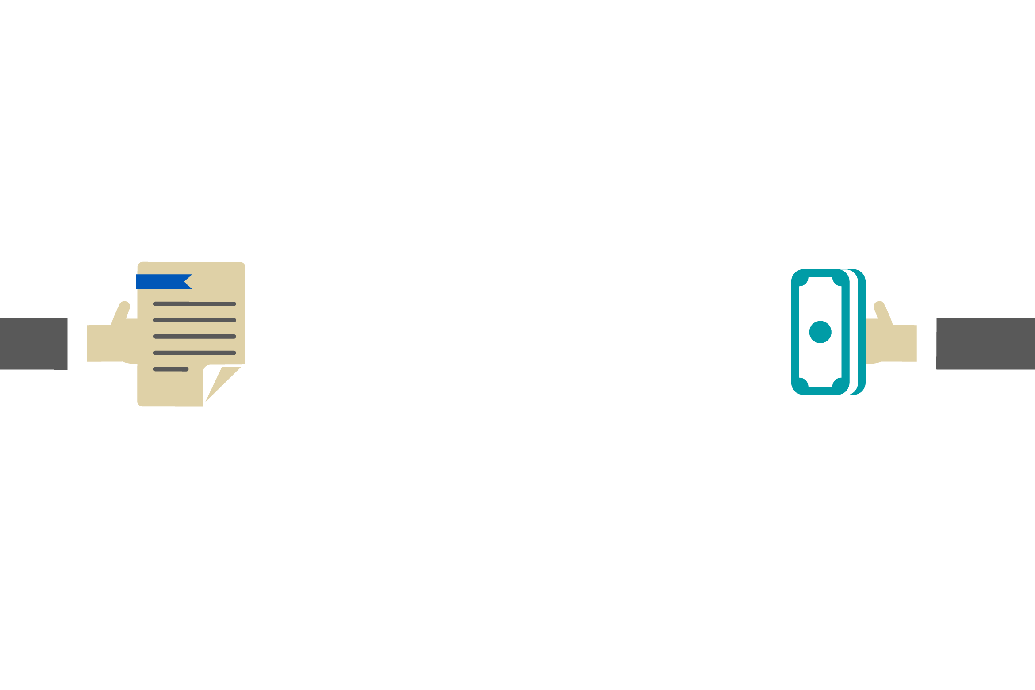
LOAN APPROVAL PHASE
Communication from your credit union: The final decision will be forwarded to you:
Loan application may be approved with conditions that must be met prior to.
Loan application may be declined. With a denial, you may consider immediate steps or longer-term strategies.
Contingencies: Meet any contingencies spelled out in the sales contract for the home:
Home inspection and other inspections, such as pest or termite.

Slide 21
PREPARING FOR CLOSING
Obtain Hazard Insurance (well before closing)
If you are purchasing a single-family residence, your credit union will require you to obtain hazard insurance for the replacement value of the property. If you are buying a condo or townhouse, get a copy of the HOA’s umbrella insurance policy. You will likely also be required to purchase insurance coverage protecting the interior, including contents.
Certain hazards are not covered in a standard policy (flood, earthquake), and you may be required to purchase additional insurance.
Members should obtain more information regarding specific insurance requirements from their credit union.

Slide 22
PREPARING FOR CLOSING
Prior to Closing: Review Closing Disclosure
The “Know Before You Owe” rules require your credit union to send you a form called a Closing Disclosure at least three business days before your loan closes. The Closing Disclosure lists your final mortgage costs in the same format as the Loan Estimate. You should compare your Loan Estimate to the Closing Disclosure and make sure that you understand the reason for any differences. Be sure to keep a copy of your Closing Disclosure; because some of the closing costs may be tax-deductible.
Closing Agent or Settlement Attorney
Generally, these important closing functions are performed by a title or escrow company. In certain regions of the country, specially trained closing attorneys deal with this task.
Title Insurance
Your credit union will recommend a title insurance provider, but you have the option to choose for yourself and decide on coverage options. Title insurance policies protect both you and the financial institution against losses resulting from certain claims, such as others claiming ownership to the property or undisclosed liens against the property.
A title insurance company will research public records to ensure that the seller holds legal title to the property and that there are no undisclosed liens or past due taxes.

Slide 23
MAINTAINING HOMEOWNERSHIP
Mortgage Payment
Confirm the amount, due date and method of payment (such as direct debit from your checking account).
Other Monthly Housing-Related Fees
Condos, townhouses and co-ops may also have monthly association fees.
Prepaying Your Mortgage
Consider making additional principal payments to speed your equity build-up.
Transfer of Servicing
If loan is transferred to another servicer, ensure payments are sent to the correct entity.

Slide 24
MAINTAINING HOMEOWNERSHIP
Consider an Impound Account
Impound accounts exist for the purpose of collecting taxes and insurance so that your credit union can remit these funds on your behalf.
Impound accounts are called escrow accounts in some parts of the country.
Ensure property taxes and insurance payments are paid current and no negative balance exists in your impound account. Adjustments to taxes and insurance payments may occur when the value of your property increases and will be reflected in your monthly payment if you have an impound account.
Preparing your Federal Tax Submission
Your mortgage servicer will send a Form 1099 early in the year (generally by Jan. 31). You may be able to deduct your mortgage interest and property taxes plus some of your closing costs. Consult with a professional tax advisor for more information.

Slide 25
MAINTAINING HOMEOWNERSHIP:
STAY CURRENT ON YOUR MORTGAGE
Financial Emergency
Always have a savings cushion.
Consider alternate sources of funds for mortgage payment.
Contact a credit counselor at your local Consumer Credit Counseling Services (CCCS).
Contact your Servicer if you are going to be late or miss a payment.
Alternatives to Foreclosure
Some of the options your servicer may present, depending on your financial circumstance, include:
Forbearance.
Loan modification.
Assumption.
Preforeclosure sale.
Deed-in-lieu of foreclosure.
archmicu.com/rtho_glossary
Please refer to the Glossary for a more in-depth definition of these terms.

Slide 26
THANK YOU

